Slide 1
Datahub - DataBricks
By Lokeswar Reddy

Slide 2
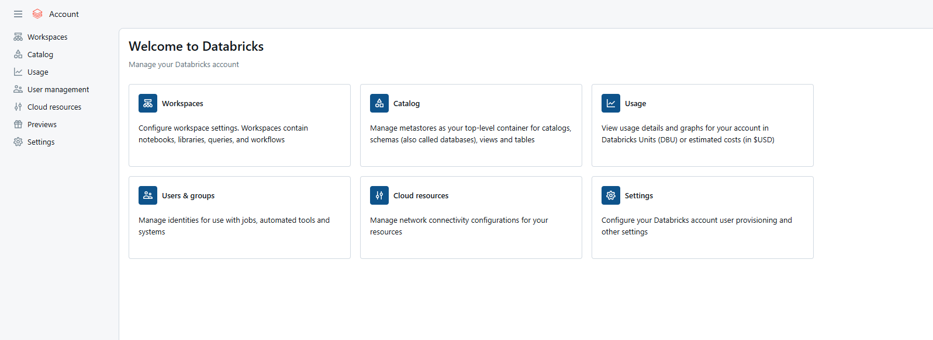
1. DataBricks Workspace
DataBricks workspace should be a premium one and create DataBricks access connector and provide storage data blob contributor for this access connector
Launch workspace and then redirect to DataBricks admin/ account console to Create Meta store/ unity catalog
click on catalog to create meta store

Slide 3
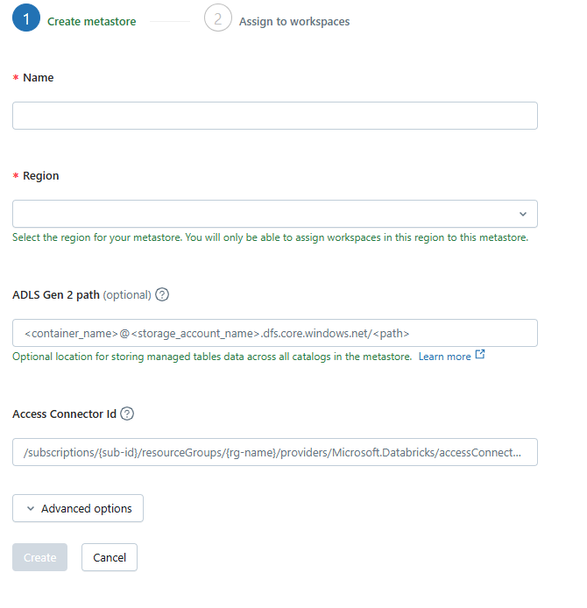
Provide the name of the metastore, region (note it’s better to have Databricks workspace and metastore in the same region).
Provide the storage account path to store transaction logs. In the end provide the databricks access connector ID which were created in the previous slide.

Slide 4
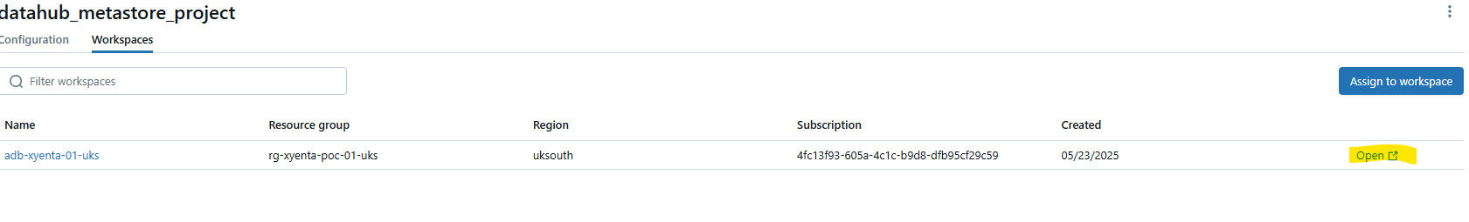
Continue…
Assign the metastore to the workspace , once after assigning the metastore to the workspace you can see like below .
In the next step guide over the user management tab, create groups like Developers, workspace admins, metastore admins and Users . We can assign these groups to our workspace in order to maintain hierarchy.
Now hit the Open button to enter into Databricks workspace environment

Slide 5
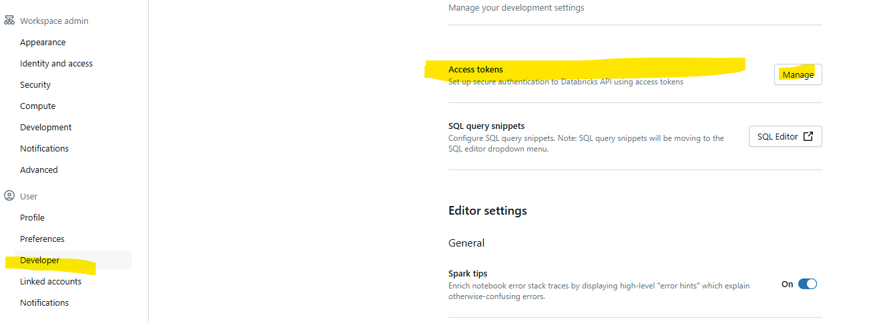
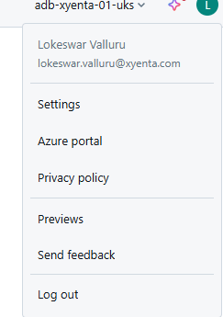
Continue..
Hover our cursor right on top of our profile and hit the setting option to get the PAT

Slide 6
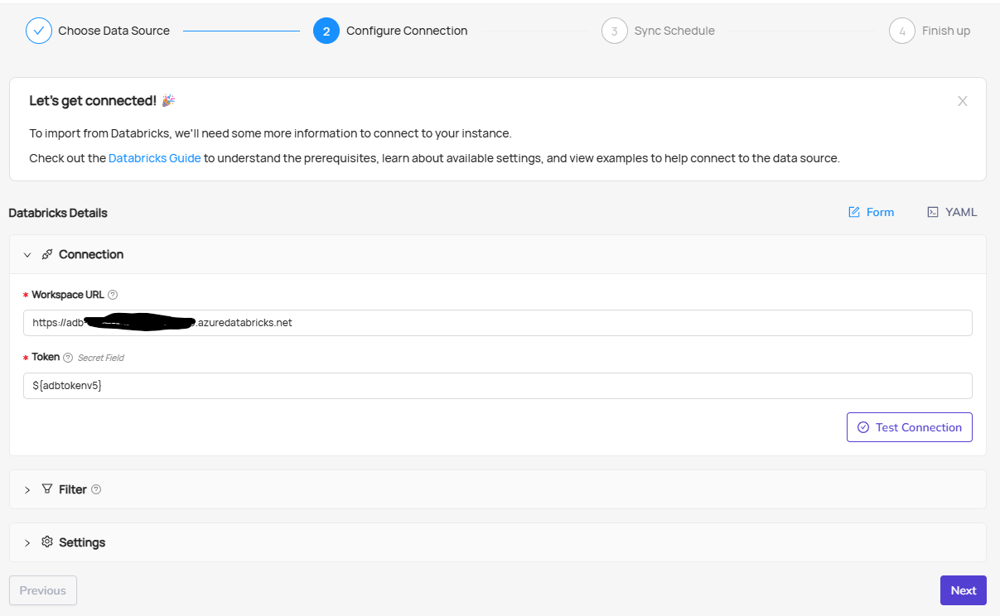
2.DataHub
Once after login to Datahub , click on create new source button and you will find DataBricks.
Provide our DataBricks workspace url and PAT token and then hit on Test connection button

Slide 7
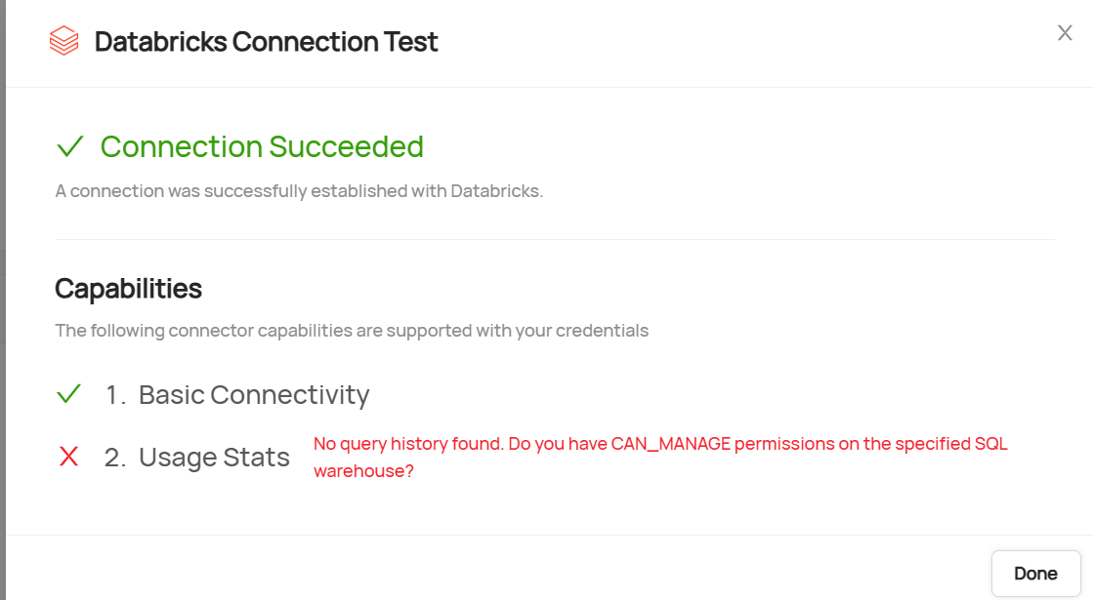
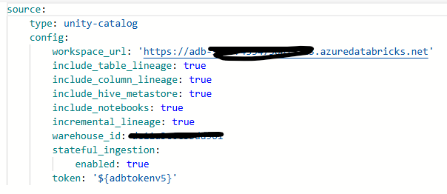
Continue….
You will get the following error’s one you hit the Test connection
To avoid those error , use YAML instead of Form also to avoid usage stats provide warehouse_id form the databricks and make sure cluster is turn on to make sure for successful connection . Once after updating the YAML code with warehouse_id then our error will gone and makes successful connection

Slide 8
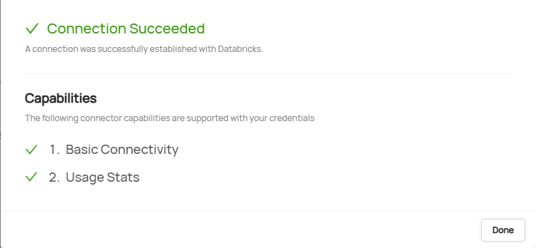
Continue…

